Slide 1
Algorithm Analysis and Design Advanced Data Structure (Binary Search Tree)
Lecture -24-25

Slide 2
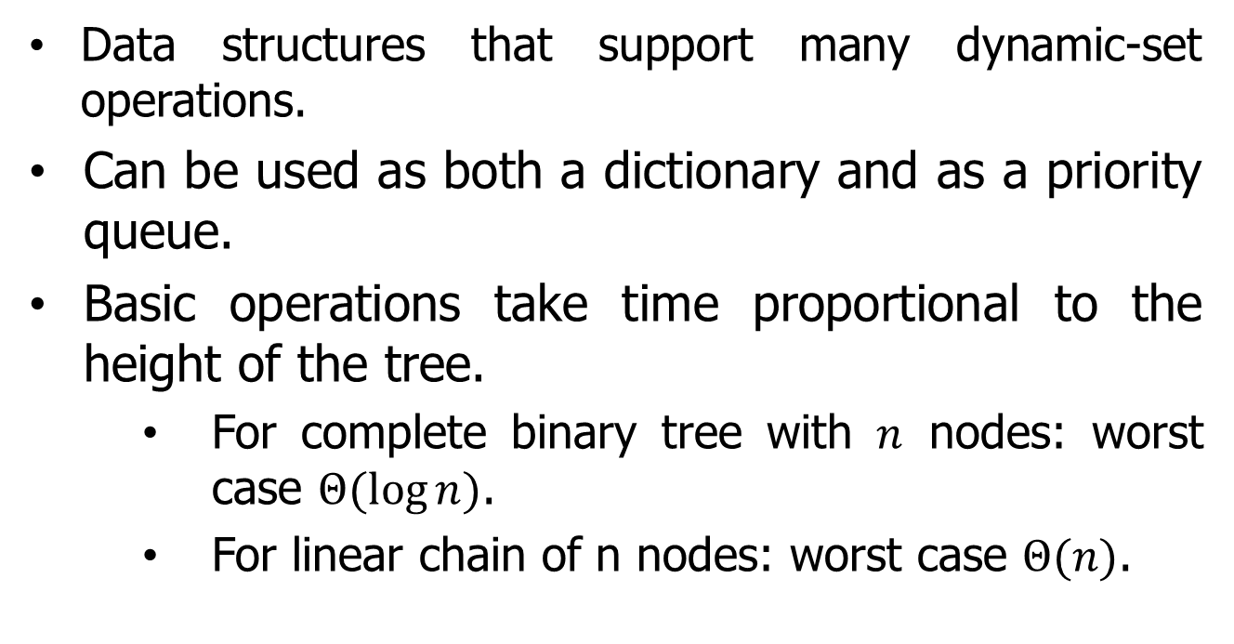
Overview
Data structures that support many dynamic-set operations.
Can be used as both a dictionary and as a priority queue.
Basic operations take time proportional to the height of the tree.
For complete binary tree with $n$ nodes: worst case $Θ(\log{n})$.
For linear chain of n nodes: worst case $Θ(n)$.

Slide 3
Trees Terminology
A tree is a data structure that represents data in a hierarchical manner.
It associates every object to a node in the tree and maintains the parent/child relationships between those nodes.
Each tree must have exactly one node, called the root, from which all nodes of the tree extend (and which has no parent of its own).
The other end of the tree – the last level down — contains the leaf nodes of the tree.

Slide 4
Trees Terminology
The number of lines you pass through when you travel from the root until you reach a particular node is the depth of that node in the tree (node G in the figure above has a depth of 2).
The height of the tree is the maximum depth of any node in the tree (the tree in given figure has a height of 3).
A
B
C
D
E
F
G
H
I
J
K

Slide 5
Trees Terminology
The number of children emanating from a given node is referred to as its degree — for example, node A above has a degree of 3 and node J has a degree of 1.
A
B
C
D
E
F
G
H
I
J
K

Slide 6
Binary Search Tree (BST)
Binary search trees are an important data structure for dynamic sets.
• Accomplish many dynamic-set operations in O(h) time,
where h = height of tree.
• A binary tree by a linked data structure in which each node is an object.
• root[T ] points to the root of tree T .
• Each node contains the fields
• key (and possibly other satellite data).
• left: points to left child.
• right: points to right child.
• p: points to parent. p[root[T ]] = NIL.

Slide 7


Binary Search Tree (BST)
• Stored keys must satisfy the binary-search-tree property.
• If y is in left subtree of x, then key[y] ≤ key[x].
• If y is in right subtree of x, then key[y] ≥ key[x].
$$x$$
10
$$y$$
6
16
3
9
14
19
17
(Figure: A BST on 8 nodes with height 3)

Slide 8

Binary Search Tree (BST)
• Stored keys must satisfy the binary-search-tree property.
• If y is in left subtree of x, then key[y] ≤ key[x].
• If y is in right subtree of x, then key[y] ≥ key[x].
$$x$$
10
6
16
$$y$$
3
9
14
19
17
(Figure: A BST on 8 nodes with height 3)

Slide 9
Binary Search Tree (BST)
Possible operations on BST
Traversing
Searching
Inserting
Deleting

Slide 10
Binary Search Tree (BST)
Possible operations on BST
Traversing
Searching
Inserting
Deleting

Slide 11
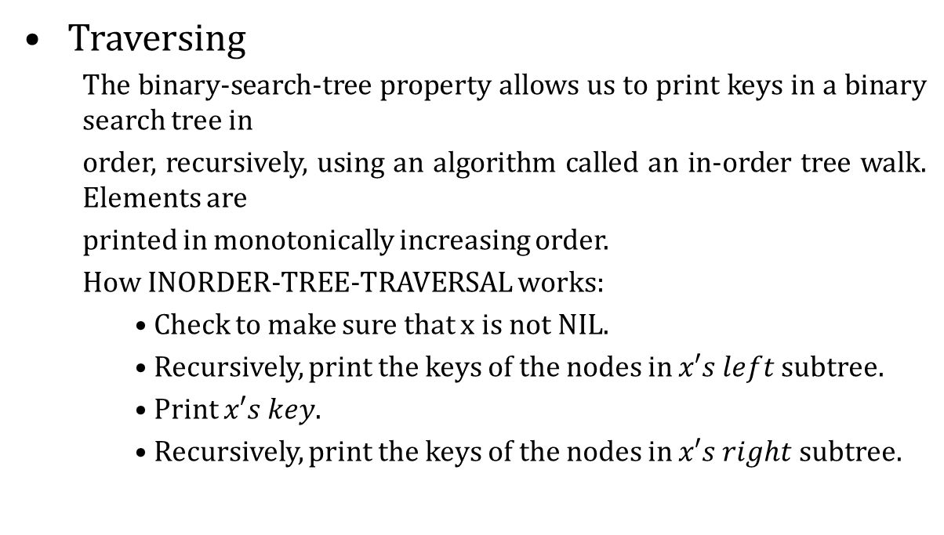
Binary Search Tree (BST)
Traversing
The binary-search-tree property allows us to print keys in a binary search tree in
order, recursively, using an algorithm called an in-order tree walk. Elements are
printed in monotonically increasing order.
How INORDER-TREE-TRAVERSAL works:
• Check to make sure that x is not NIL.
• Recursively, print the keys of the nodes in $x′s left$subtree.
• Print $x′s key$.
• Recursively, print the keys of the nodes in $x′s right$subtree.

Slide 12
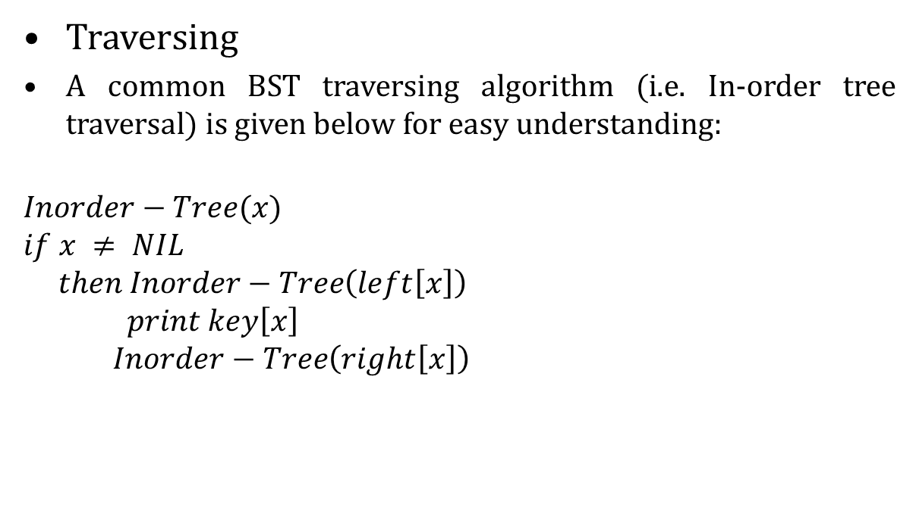
Binary Search Tree (BST)
Traversing
A common BST traversing algorithm (i.e. In-order tree traversal) is given below for easy understanding:
$$Inorder−Tree(x)$$
$$if x ≠ NIL$$
$$then Inorder−Tree\left(left\left[x\right]\right)$$
$$print key\left[x\right]$$
$$Inorder−Tree\left(right\left[x\right]\right)$$
10
6
16
3
9
14
19
17

Slide 13
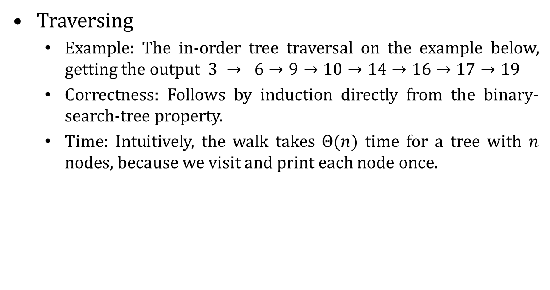
Binary Search Tree (BST)
Traversing
Example: The in-order tree traversal on the example below, getting the output $3 → 6→9→10→14→16→17→19$
Correctness: Follows by induction directly from the binary-search-tree property.
Time: Intuitively, the walk takes $Θ(n)$ time for a tree with $n$ nodes, because we visit and print each node once.
10
6
16
3
9
14
19
17

Slide 14
Binary Search Tree (BST)
Possible operations on BST
Traversing
Searching
Inserting
Deleting

Slide 15
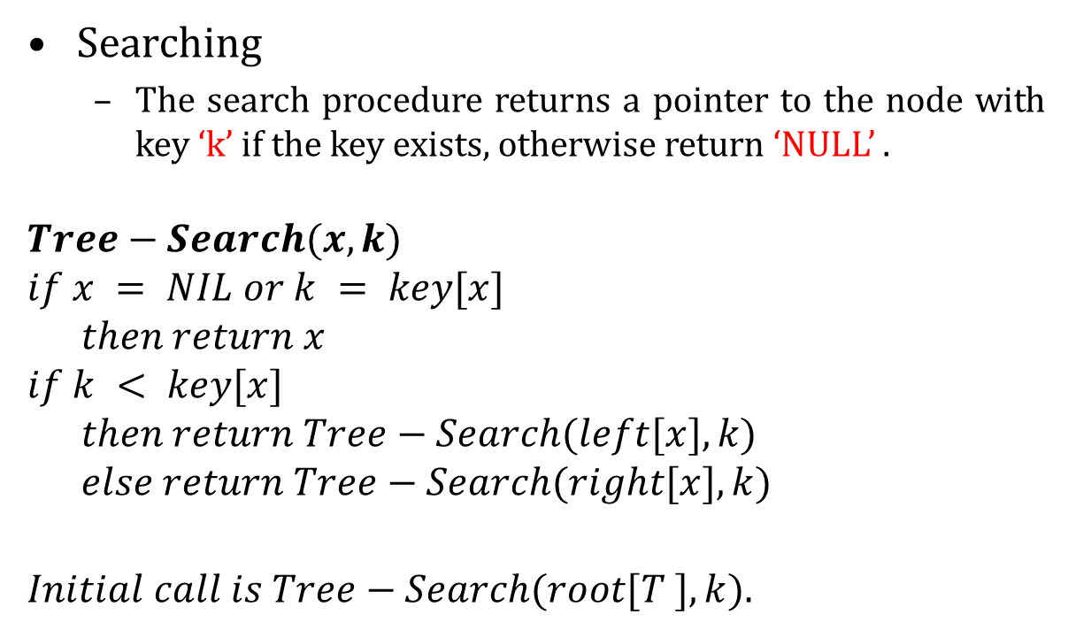
Binary Search Tree (BST)
Searching
The search procedure returns a pointer to the node with key ‘k’ if the key exists, otherwise return ‘NULL’ .
$$Tree−Search(x, k)$$
$$if x = NIL or k = key[x]$$
$$then return x$$
$$if k < key[x]$$
$$then return Tree−Search(left[x], k)$$
$$else return Tree−Search(right[x], k)$$
$$Initial call is Tree−Search(root[T ], k).$$

Slide 16
Binary Search Tree (BST)
Searching
How to search key 13 on the following Tree.
15
6
18
3
7
17
20
2
4
13
9

Slide 17
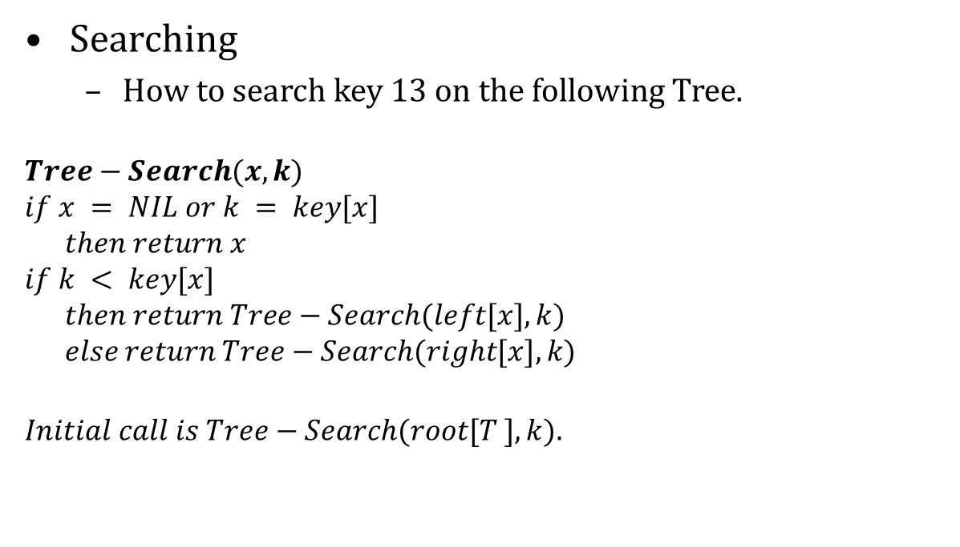
Binary Search Tree (BST)
Searching
How to search key 13 on the following Tree.
$$Tree−Search(x, k)$$
$$if x = NIL or k = key[x]$$
$$then return x$$
$$if k < key[x]$$
$$then return Tree−Search(left[x], k)$$
$$else return Tree−Search(right[x], k)$$
$$Initial call is Tree−Search(root[T ], k).$$
15
6
18
3
7
17
20
2
4
13
9

Slide 18
Binary Search Tree (BST)
Searching
How to search key 13 on the following Tree.
$$Tree−Search(x, k)$$
$$if x = NIL or k = key[x]$$
$$then return x$$
$$if k < key[x]$$
$$then return Tree−Search(left[x], k)$$
$$else return Tree−Search(right[x], k)$$
$$Initial call is Tree−Search(root[T ], k).$$
15
6
18
3
7
17
20
2
4
13
9
$$15→6→7→13$$
Time: The algorithm is recursive and visit nodes on a downward path from the root. Thus, running time is $O(h)$, where h is the height of the tree.

Slide 19
Binary Search Tree (BST)
Searching (Minimum and Maximum)
The binary-search-tree property guarantees that
• the minimum key of a binary search tree is located at the leftmost node, and
• the maximum key of a binary search tree is located at the rightmost node.
Traverse the appropriate pointers (left or right) until NIL is reached.

Slide 20
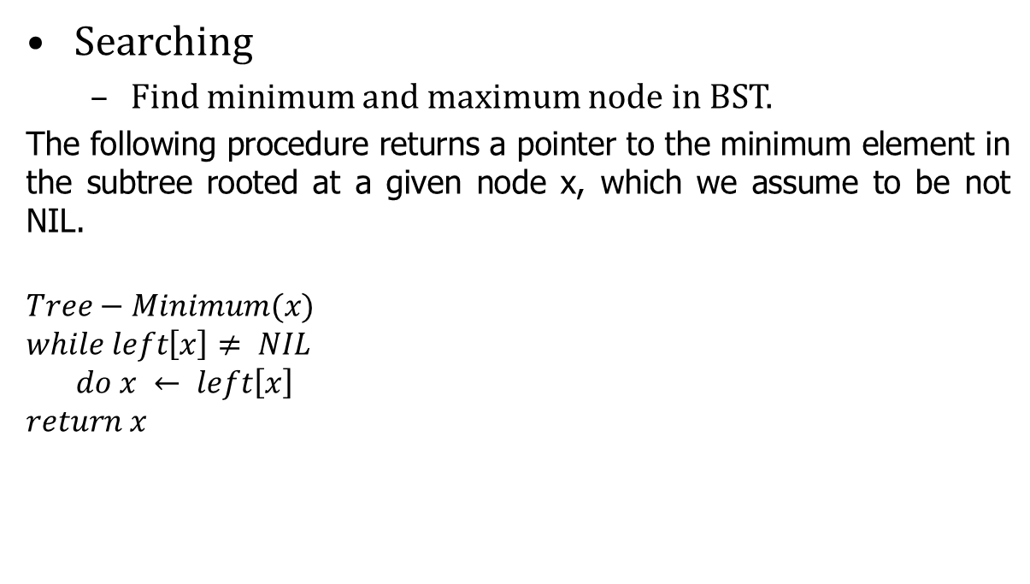
Binary Search Tree (BST)
Searching
Find minimum and maximum node in BST.
The following procedure returns a pointer to the minimum element in the subtree rooted at a given node x, which we assume to be not NIL.
$$Tree−Minimum(x)$$
$$while left\left[x\right]≠ NIL$$
$$do x ← left\left[x\right]$$
$$return x$$
15
6
18
3
7
17
20
2
4
13
9

Slide 21
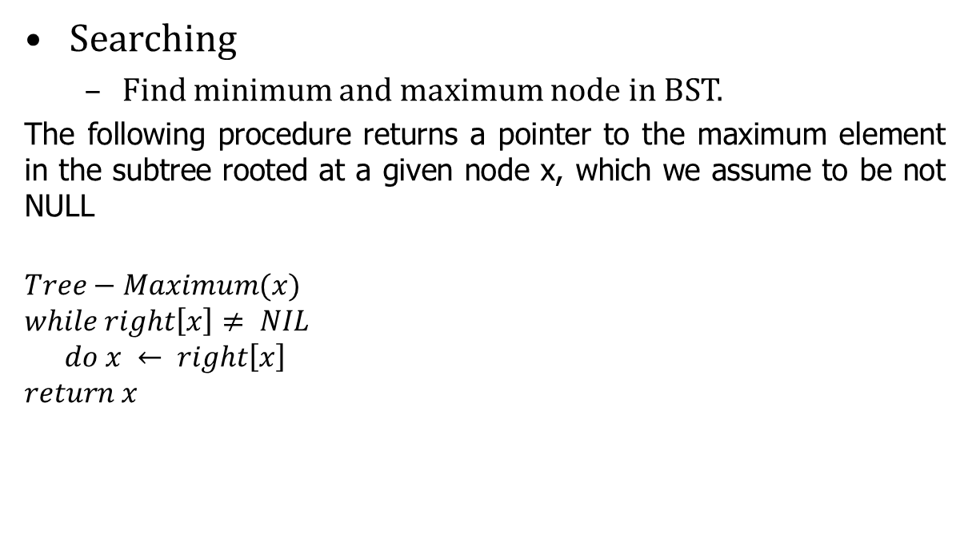
Binary Search Tree (BST)
Searching
Find minimum and maximum node in BST.
The following procedure returns a pointer to the maximum element in the subtree rooted at a given node x, which we assume to be not NULL
$$Tree−Maximum(x)$$
$$while right\left[x\right]≠ NIL$$
$$do x ← right\left[x\right]$$
$$return x$$
15
6
18
3
7
17
20
2
4
13
Time: Both procedures visit nodes that form a downward path from the root to a leaf. Both procedures run in O(h) time, where h is the height of the tree.
9

Slide 22
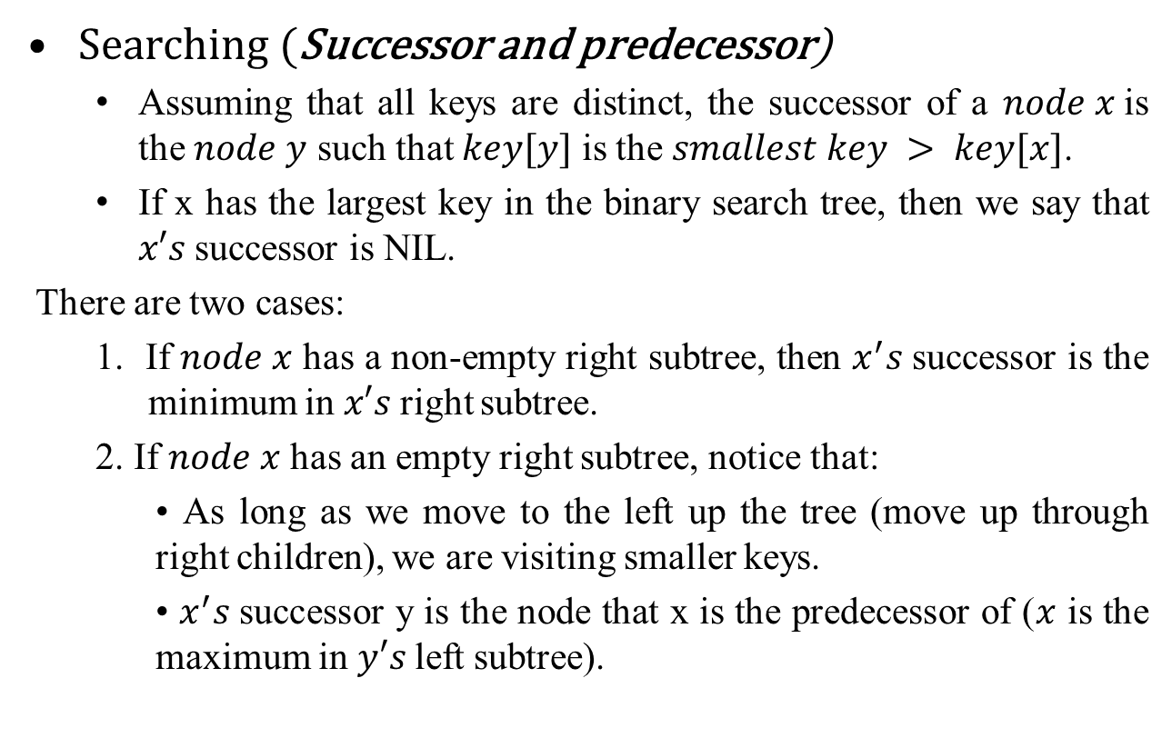
Binary Search Tree (BST)
Searching (Successor and predecessor)
Assuming that all keys are distinct, the successor of a $node x$is the $node y$ such that $key[y]$ is the $smallest key > key[x]$.
If x has the largest key in the binary search tree, then we say that $x′s$successor is NIL.
There are two cases:
1. If $node x$ has a non-empty right subtree, then $x^{′}s$successor is the minimum in $x′s$right subtree.
2. If $node x$ has an empty right subtree, notice that:
• As long as we move to the left up the tree (move up through right children), we are visiting smaller keys.
• $x^{′}s$successor y is the node that x is the predecessor of ($x$ is the maximum in $y′s$left subtree).

Slide 23
Binary Search Tree (BST)
Searching (Successor and predecessor)
Find successor node in BST.
Let us find the successor() with the help of a tree example.
Successor:
The next increased value of node x.
i.e. The successor of node 15 is 17
and
The successor of node 13 is 15
15
6
18
3
7
17
20
2
4
13
9

Slide 24
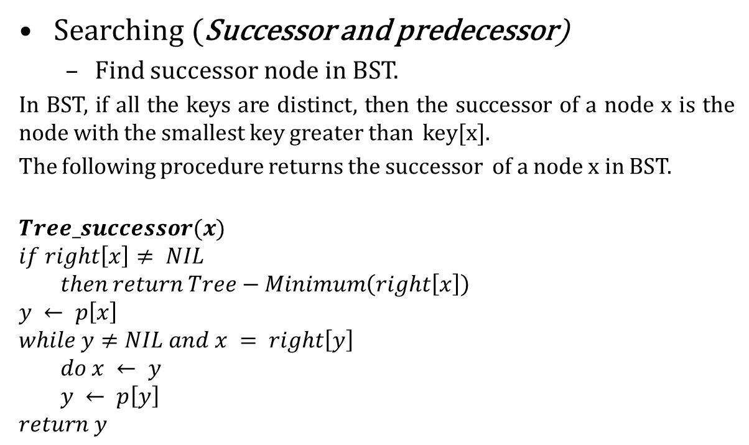
Binary Search Tree (BST)
Searching (Successor and predecessor)
Find successor node in BST.
In BST, if all the keys are distinct, then the successor of a node x is the node with the smallest key greater than key[x].
The following procedure returns the successor of a node x in BST.
$$Tree_successor(x)$$
$$if right\left[x\right]≠ NIL$$
$$then return Tree−Minimum\left(right\left[x\right]\right)$$
$$y ← p\left[x\right]$$
$$while y≠NIL and x = right\left[y\right]$$
$$do x ← y$$
$$y ← p\left[y\right]$$
$$return y$$
15
6
18
3
7
17
20
2
4
13
9

Slide 25
Binary Search Tree (BST)
Searching (Successor and predecessor)
Find predecessor node in BST.
In BST, if all the keys are distinct, then the in-order predecessor of a node x is the previous node in in-order traversal of it.
Let us find the in-order predecessor () with the help of a tree example.
For Example :
In-order predecessor of 2 do not exist.
In-order predecessor of 15 is 13
In-order predecessor of 18 is 17
15
6
18
3
7
17
20
2
4
13
9

Slide 26
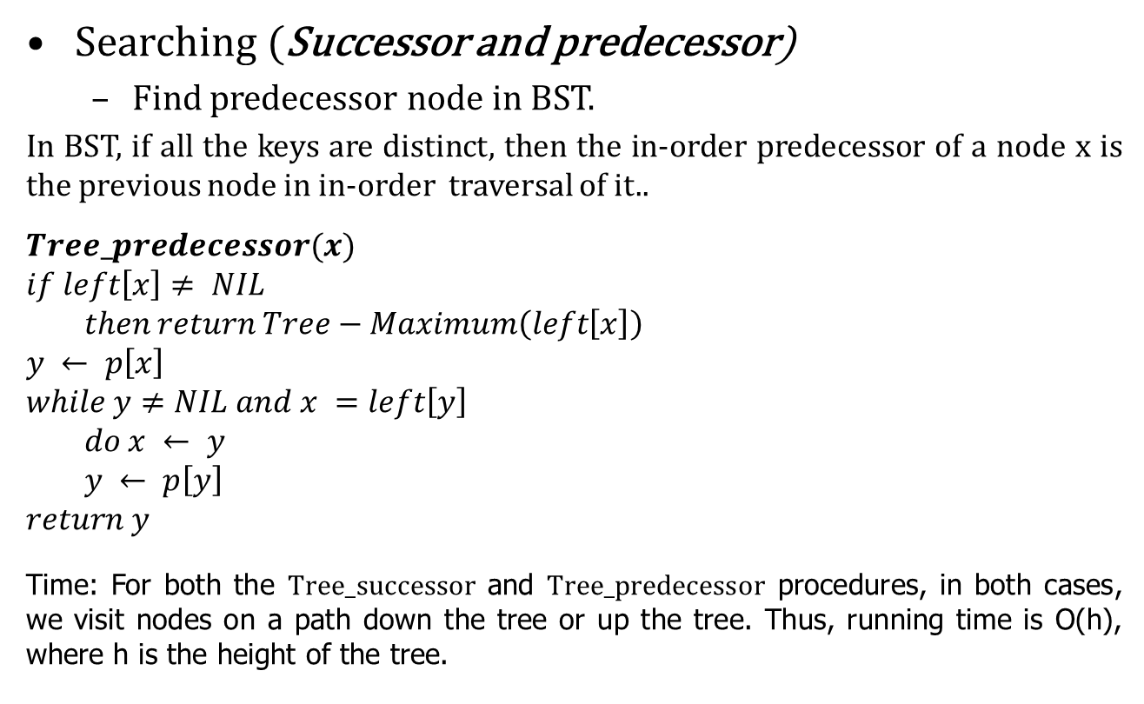
Binary Search Tree (BST)
Searching (Successor and predecessor)
Find predecessor node in BST.
In BST, if all the keys are distinct, then the in-order predecessor of a node x is the previous node in in-order traversal of it..
$$Tree_predecessor(x)$$
$$if left\left[x\right]≠ NIL$$
$$then return Tree−Maximum\left(left\left[x\right]\right)$$
$$y ← p\left[x\right]$$
$$while y≠NIL and x =left\left[y\right]$$
$$do x ← y$$
$$y ← p\left[y\right]$$
$$return y$$
Time: For both the $Tree_successor$ and $Tree_predecessor$ procedures, in both cases, we visit nodes on a path down the tree or up the tree. Thus, running time is O(h), where h is the height of the tree.
15
6
18
3
7
17
20
2
4
13
9

Slide 27
Binary Search Tree (BST)
Possible operations on BST
Traversing
Searching
Inserting
Deleting

Slide 28
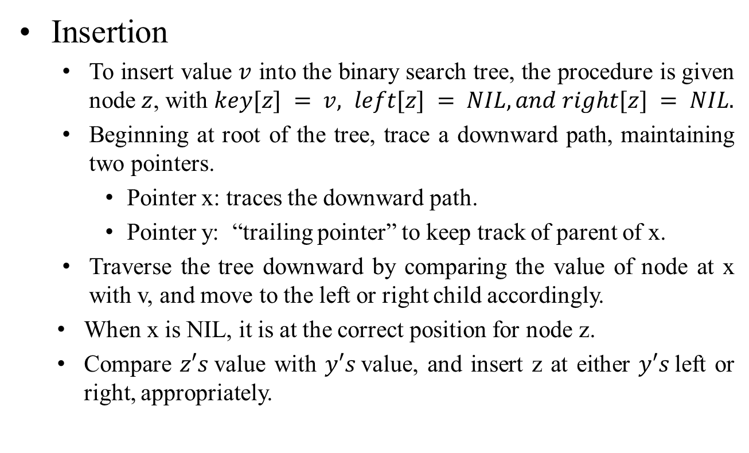
Binary Search Tree (BST)
Insertion
To insert value $v$ into the binary search tree, the procedure is given node $z$, with $key[z] = v, left[z] = NIL, and right[z] = NIL.$
Beginning at root of the tree, trace a downward path, maintaining two pointers.
Pointer x: traces the downward path.
Pointer y: “trailing pointer” to keep track of parent of x.
Traverse the tree downward by comparing the value of node at x with v, and move to the left or right child accordingly.
When x is NIL, it is at the correct position for node z.
Compare $z′s$value with $y′s$value, and insert z at either $y′s$left or right, appropriately.

Slide 29
Binary Search Tree (BST)
Insertion
Example: insert 14
15
6
18
3
7
17
20
2
4
13
9

Slide 30
Binary Search Tree (BST)
Insertion
Example: insert 14
15
15
6
18
6
18
3
7
17
20
3
7
17
20
2
4
13
2
4
13
9
14
9

Slide 31

Binary Search Tree (BST)
Insertion
15
$$Tree−Insert(T, z)$$
$$y ← NIL$$
$$x ← root[T ]$$
$$while x ≠ NIL$$
$$do y ← x$$
$if key[z] < key[x]$
$then x ← left[x]$
$else$
$x ← right[x]$
$$p[z] ← y$$
$$if y = NIL$$
$$then root\left[T \right]←z⊳ Tree T was empty$$
$$else if key[z] < key[y]$$
$$then left[y] ← z$$
$$else$$
$right[y] ← z$
6
18
3
7
17
20
2
4
13
9
14

Slide 32
Binary Search Tree (BST)
Insertion (Time complexity)
Same as Tree-Search() . On a tree of height h, procedure takes O(h) time.
Tree-Insert() can be used with Inorder-Tree() to sort a given set of numbers.
15
6
18
3
7
17
20
2
4
13
9
14

Slide 33
Binary Search Tree (BST)
Possible operations on BST
Traversing
Searching
Inserting
Deleting

Slide 34
Binary Search Tree (BST)
Deletion
TREE-DELETE is broken into three cases.
Case 1: node z has no children.
Delete node z by making the parent of z point to NULL, instead of to z.
Case 2: node z has one child.
Delete z by making the parent of z point to z.s child, instead of to z.
Case 3: z has two children.
node z’s successor y has either no children or one child. (y is the minimum node.with no left child.in z.s right subtree.)
Delete y from the tree (via Case 1 or 2).
Replace z.s key and satellite data with y.s.

Slide 35
Binary Search Tree (BST)
Deletion
TREE-DELETE is broken into three cases.
Case 1: node z has no children.
Delete node z by making the parent of z point to NULL, instead of to z.
Example: Delete 14
15
6
18
3
7
17
20
2
4
13
9
14

Slide 36
Binary Search Tree (BST)
Deletion
Case 1: node z has no children.
Delete node z by making the parent of z point to NULL, instead of to z.
Example: Delete 14
15
15
6
18
6
18
3
7
17
20
3
7
17
20
2
4
13
2
4
13
9
14
Deletion of node 14 done successfully
9
Before deletion
14
After deletion

Slide 37
Binary Search Tree (BST)
Deletion
Case 2: node z has one child.
Delete z by making the parent of z point to z.s child, instead of to z.
Example: Delete node 13
15
6
18
3
7
17
20
2
4
13
9

Slide 38
Binary Search Tree (BST)
Deletion
Case 2: node z has one child.
Delete z by making the parent of z point to z.s child, instead of to z.
Example: Delete node 13
15
15
6
18
6
18
3
7
17
20
3
7
17
20
2
4
13
2
4
13
9
Deletion of node 13 done successfully
9
Before deletion
After deletion

Slide 39
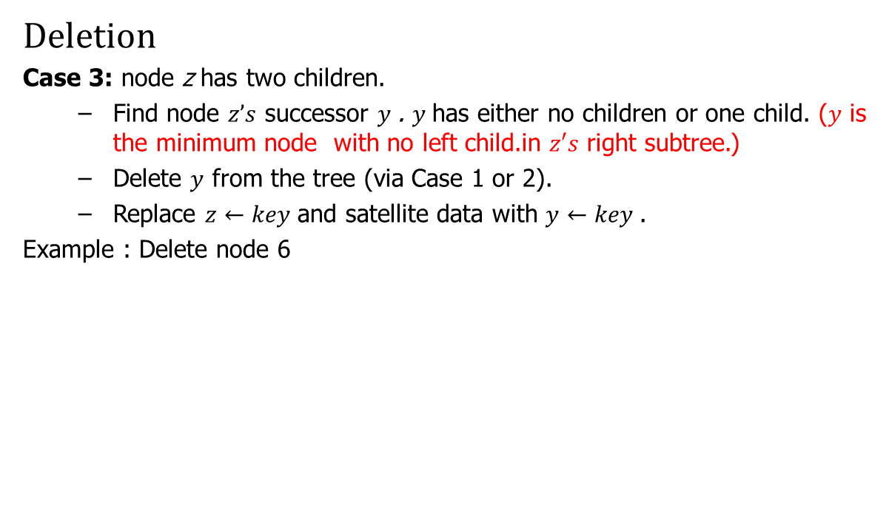
Binary Search Tree (BST)
Deletion
Case 3: node z has two children.
Find node $z’s$ successor $y$. $y$has either no children or one child. ($y$ is the minimum node with no left child.in $z′s$ right subtree.)
Delete $y$ from the tree (via Case 1 or 2).
Replace $z←key$and satellite data with $y←key$.
Example : Delete node 6
15
6
18
3
7
17
20
2
4
9

Slide 40
Binary Search Tree (BST)
Deletion
Case 3: node z has two children.
Find node $z’s$ successor $y$. $y$has either no children or one child. ($y$ is the minimum node with no left child.in $z′s$ right subtree.)
Delete $y$ from the tree (via Case 1 or 2).
Replace $z←key$and satellite data with $y←key$.
Example : Delete node 6
15
6
18
3
7
17
20
2
4
9
In-order successor of node 6

Slide 41
Binary Search Tree (BST)
Deletion
Case 3: node z has two children.
Find node $z’s$ successor $y$. $y$has either no children or one child. ($y$ is the minimum node with no left child.in $z′s$ right subtree.)
Delete $y$ from the tree (via Case 1 or 2).
Replace $z←key$and satellite data with $y←key$.
Example : Delete node 6
15
15
7
18
6
18
3
9
17
20
3
7
17
20
2
4
2
4
9
In-order successor of node 6
6
Deletion of node 6 done successfully

Slide 42
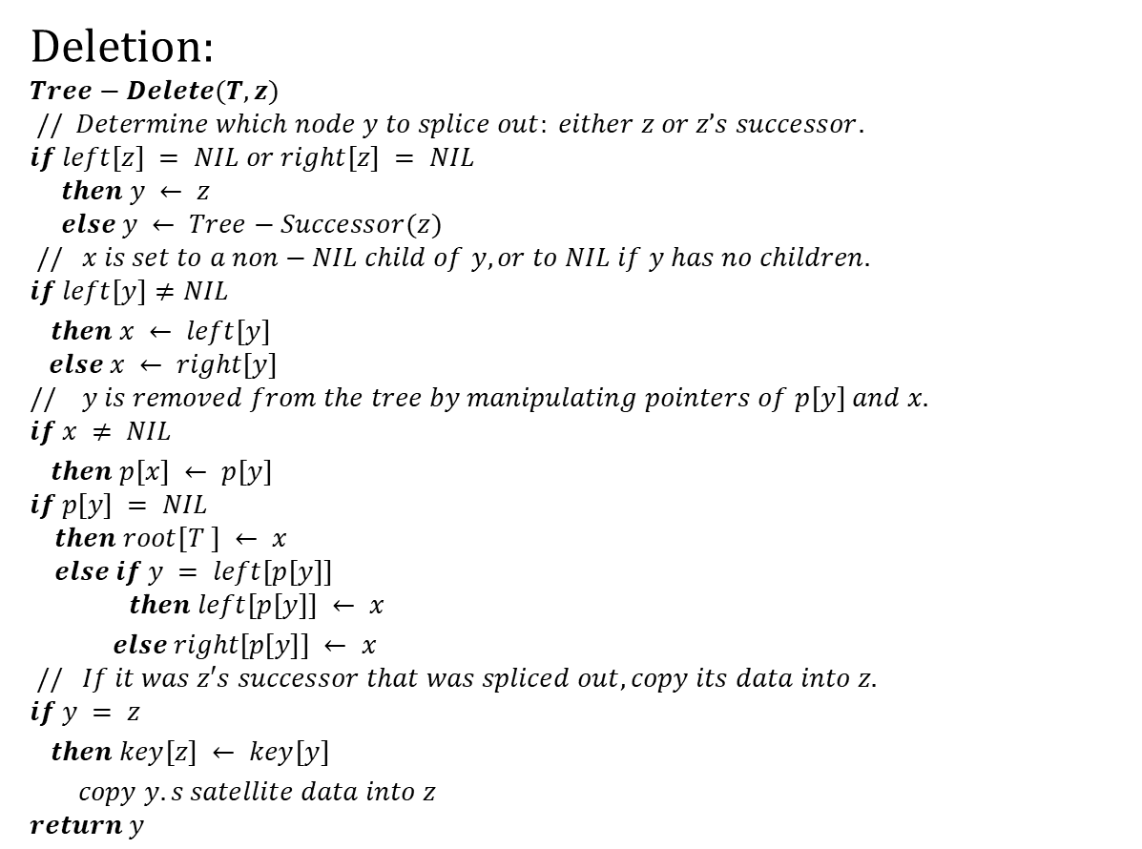
Binary Search Tree (BST)
Deletion:
$$Tree−Delete(T, z)$$
$$// Determine which node y to splice out: either z or z’s successor.$$
$$if left[z] = NIL or right[z] = NIL$$
$$then y ← z$$
$$else y ← Tree−Successor(z)$$
$$// x is set to a non−NIL child of y, or to NIL if y has no children.$$
$$if left[y]≠NIL$$
$then x ← left[y]$
$$else x ← right[y]$$
$$// y is removed from the tree by manipulating pointers of p[y] and x.$$
$$if x ≠ NIL$$
$then p[x] ← p[y]$
$$if p[y] = NIL$$
$$then root[T ] ← x$$
$$else if y = left[p[y]]$$
$$then left[p[y]] ← x$$
$else right[p[y]] ← x$
$$// If it was z′s successor that was spliced out, copy its data into z.$$
$$if y = z$$
$then key[z] ← key[y]$
$copy y.s satellite data into z$
$$return y$$

Slide 43
Binary Search Tree (BST)
Deletion:
$$Tree−Delete(T, z)$$
$$// Determine which node y to splice out: either z or z’s successor.$$
$$if left[z] = NIL or right[z] = NIL$$
$$then y ← z$$
$$else y ← Tree−Successor(z)$$
$$// x is set to a non−NIL child of y, or to NIL if y has no children.$$
$$if left[y]≠NIL$$
$then x ← left[y]$
$$else x ← right[y]$$
$$// y is removed from the tree by manipulating pointers of p[y] and x.$$
$$if x ≠ NIL$$
$then p[x] ← p[y]$
$$if p[y] = NIL$$
$$then root[T ] ← x$$
$$else if y = left[p[y]]$$
$$then left[p[y]] ← x$$
$else right[p[y]] ← x$
$$// If it was z′s successor that was spliced out, copy its data into z.$$
$$if y = z$$
$then key[z] ← key[y]$
$copy y.s satellite data into z$
$$return y$$
Time: O(h), on a tree of height h.

Slide 44

Thank U

